Slide 1
PROGRESS REPORT
Virtual EV Challenge
Team Evolution

Slide 2
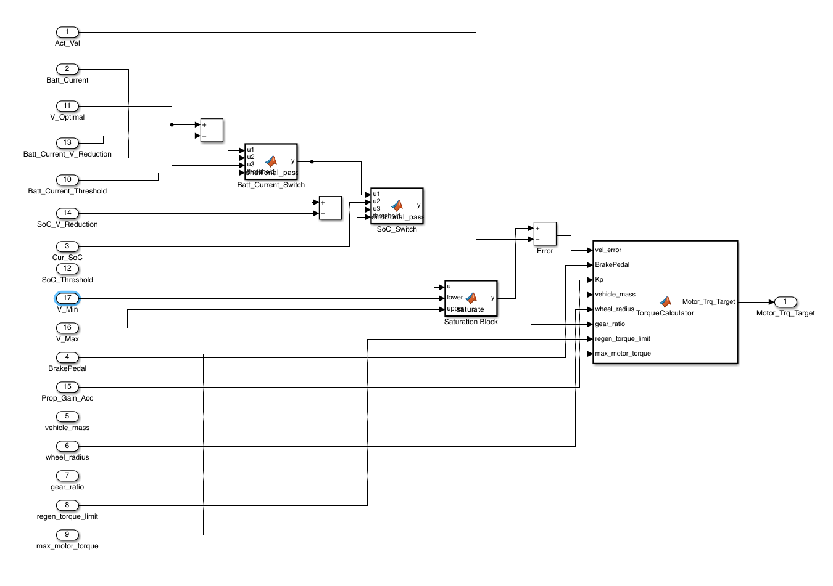
Velocity & Torque Optimization
Torque Calculator Function Computes required motor torque using core parameters like vehicle mass, wheel radius, and velocity error. Switches intelligently between acceleration and regen braking while respecting torque limits. Successfully validated in Phase 1 FMU.
Optimal Velocity Selection Optimal velocity is determined from test runs to optimize efficiency. FMU switches velocity dynamically based on SoC and battery current to balance range and performance.
Why Proportional-Only Control? We opted for proportional-only control as it delivers a fast, stable response for velocity tracking, while built-in logic handles smooth switching between acceleration and regenerative braking. This simplifies implementation and improves FMU real-time compatibility.

Slide 3
Charging Decision Controller
Role of This FMU
This FMU exclusively monitors the vehicle’s current state and rises a “Charging Request” whenever charging is needed.
Continuous Charge Need Assessment
It continuously checks SoC, battery current, and route constraints to decide whether a charge is required.
Reachability & Target Calculation
If charging is needed, the FMU identifies all physically reachable stations and computes the Target SoC and Estimated Time of Arrival (ETA) for each.

Slide 4
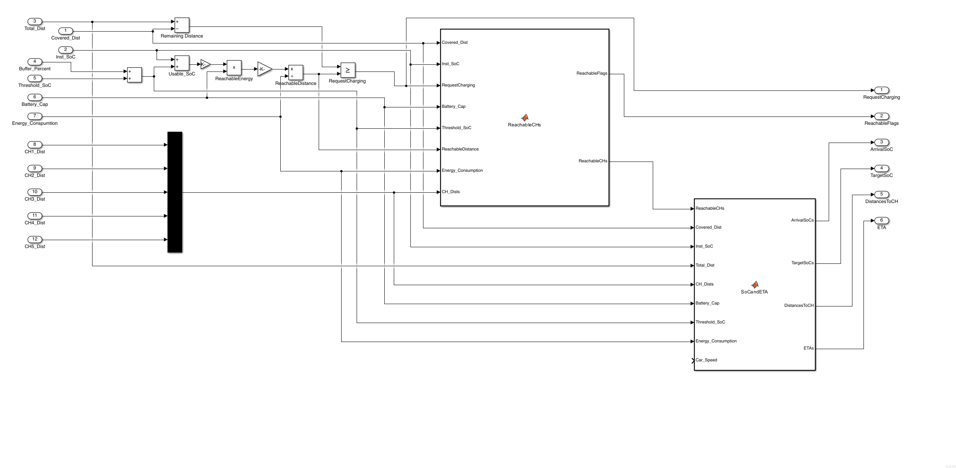
Charging Decision Controller

Slide 5
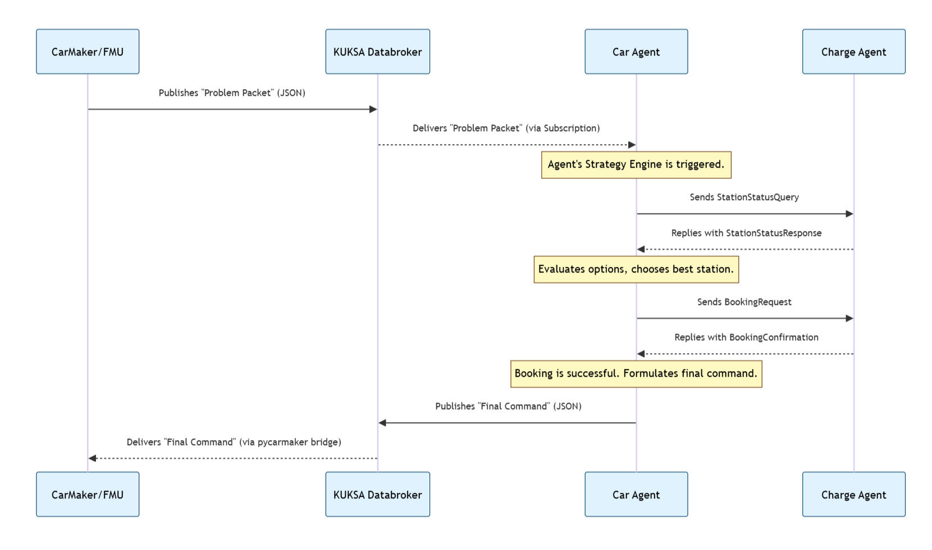
Message flow

Slide 6
Car agent
Role: The Vehicle’s Navigator
The Car Agent acts as the vehicle’s “pilot,” responsible for selecting the single best charging station based on real-time conditions.
Multi-Factor Strategy Engine
A weighted cost function evaluates:
Time: Travel, queue, and charging duration
Availability: BUSY, FREE, MAINTENANCE
Continuous Dynamic Re-Evaluation
The Car Agent continuously monitors vehicle state via FMU data. If conditions change (e.g., SoC drops unexpectedly), it aborts the current plan and triggers a fresh decision cycle.

Slide 7
CHARGE agent
Role: Central Network Coordinator
The Charge Agent serves as the manager of the charging network — tracking station availability, queue lengths, and handling all booking requests in real time.
Smart Reservation & Scheduling
It handles advanced scheduling using ETA data from vehicles:
Reserves stations dynamically
Cancels bookings for no-shows
Frees up chargers efficiently to reduce downtime and improve throughput
Failure Management
In case of charger outages or network failures, the Charge Agent broadcasts alerts instead of waiting for pull requests. The Car Agent instantly receives these and re-routes if its current plan is affected.

Slide 8
Agent COMMUNICATION PRTOCOL
StationStatusQuery – Used by the Car Agent to request real-time data for a specific list of reachable charging stations. Includes: station_ids: list[int], e.g., [1, 3, 4].
StationStatusResponse – Sent by the Charge Agent in response to the query. Returns live data for each requested station as a dictionary: station_data: dict where each key is a station ID and the value includes fields like "wait_mins", "cost_per_kwh", and "status".
BookingRequest – Sent by the Car Agent to formally request a reservation at the chosen optimal station. Contains: station_id: int and eta_seconds: int for advanced scheduling.
BookingConfirmation – Sent by the Charge Agent to confirm whether the reservation was successful. Includes: booking_status: str (e.g., "CONFIRMED" or "FAILED") and booking_id: str for confirmed bookings.
StationStatusAlert – Broadcasted by the Charge Agent to notify all agents when a station’s status changes unexpectedly (e.g., outage or maintenance). Fields: station_id: int, new_status: str, such as "MAINTENANCE".

Slide 9
Thank You

